Slide 1

NCAA Basketball Transfer Finder
Connecting teams and players to improve careers

Slide 2
The Transfer Problem
2021 brought a new transfer rule change to major NCAA sports
Players can now transfer to play at a new school immediately
Previously players were required to sit out a year before playing at a new school
Result: 1600 players requested to transfer in 2021, an increase of over 150% from 700 in 2020
Problem: Coaches are now sent scrambling to evaluate thousands of players in a matter of weeks to reach out to those they want to recruit to their team for the next year
Players that are missed by coaches do not have access to the full range of opportunities that they should
Better evaluation tools are needed for coaches to quickly identify players that fit their team
Notes:
Transfer rule is very popular, giving players the freedom to play wherever whenever without excessive penalties wasting their careers
Needs to be better evaluation tools available for coaches to identify players quickly that fit their team before the players commit to new teams
Speed is critical in this evaluation period
Players deserve to get the best fit that will help their future playing careers without letting opportunities slip through the cracks

Slide 3

Transfer Evaluation App
NCAA Basketball Player Transfer Evaluator
Notes:
Explain layout. Shooting Big with blocks per minute. Team needs someone that can provide both offense and defense. A shooting big can shoot to score points but then we want to sort by blocks to show that this player is tall and can stay near the basket and block anyone on the other team who tries to shoot close shots. Point out filter on player type and sort column. Coach can see other stats and decide if the player seems like a fit. The coach user may send Dakota Rivers a message that he wants to have a conversation and potentially recruit him to his team.

Slide 4
Data
Data was obtained from sports-reference.com using the sportsipy python package API
Contains raw player statistics data from the 2020-21 season for all NCAA players and teams
Each row is one player, columns are summary statistics for that player’s stats
Cleaning
Removed Seniors that are ineligible to transfer
Filtered out players that played less than 100 total minutes last season
Feature engineering to get statistics per minute
Notes:
Give reasoning for all bullets

Slide 5
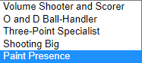
Clustering Player Types
Used K-Means clustering on ~10 select features to create new player types
Features: stats per minute, height, shooting percentages, etc.
Five clusters chosen
Metrics: within-cluster SSE, Silhouette score
Five players on court for each team at once
Able to make descriptive player type labels
Typical player types (guard, forward, etc.) are outdated and too general
Every team has a unique play style
Descriptive player type labels helps recruit players that fit team style
Notes:
K-means chosen due to wanting equal clusters
Talk about dropdown menu being the cluster labels

Slide 6
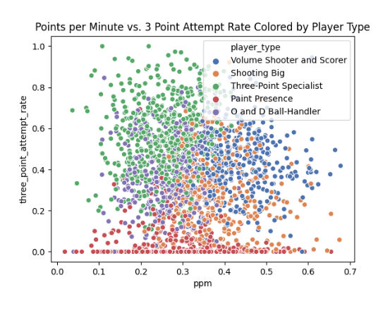
Clustering Visualized
Clusters begin to show meaningful separation even across just two dimensions
Want to expand on this and use GMMs as well as trying many more clusters (10-15) to see if more unique player types could be found
Also want to generate flags where players with special traits could be found
Three Point Attempt Rate
Points per Minute
Notes:
Really interesting to see the separation this quickly
Can niche player types be found with GMMs?

Slide 7

Thank you!
Nicholas Nigro
nicholasnigro2021@u.northwestern.edu

